Slide 1
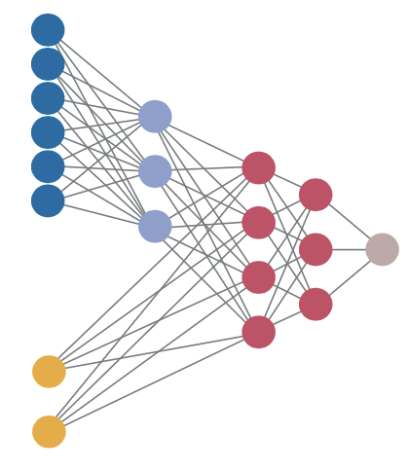
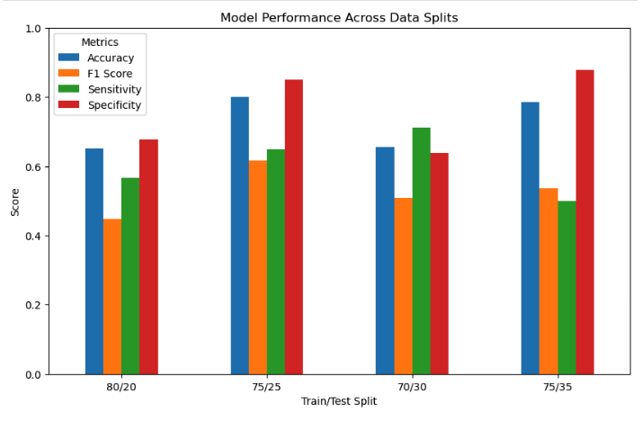
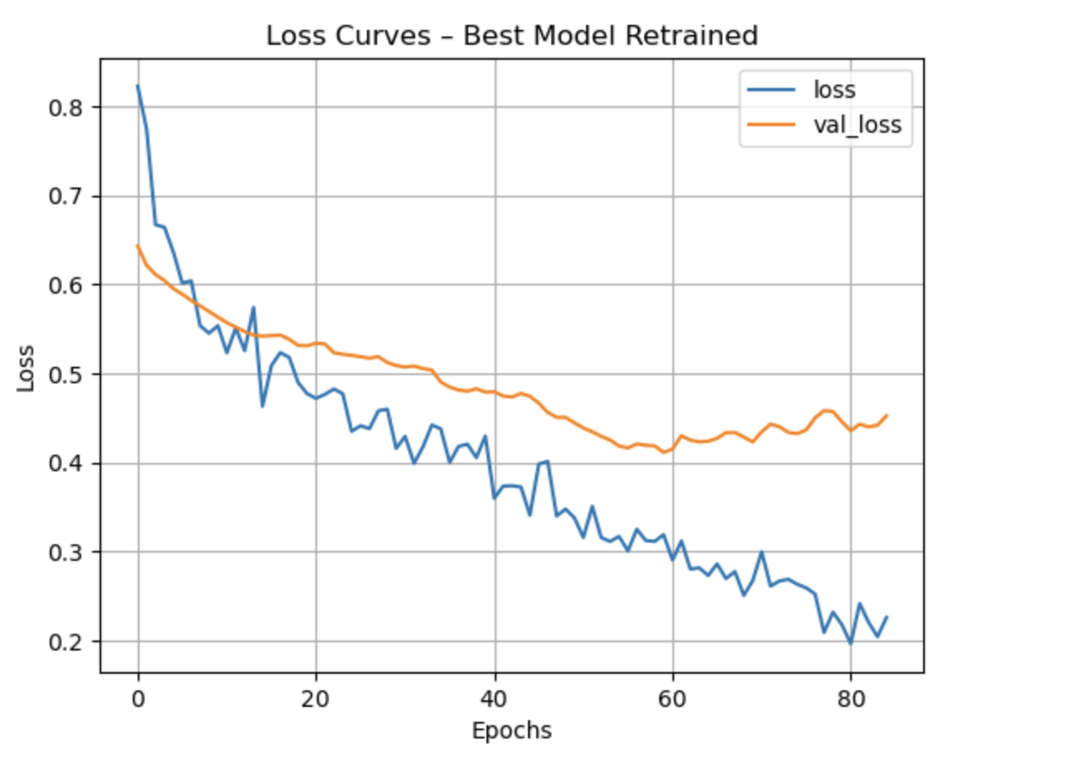
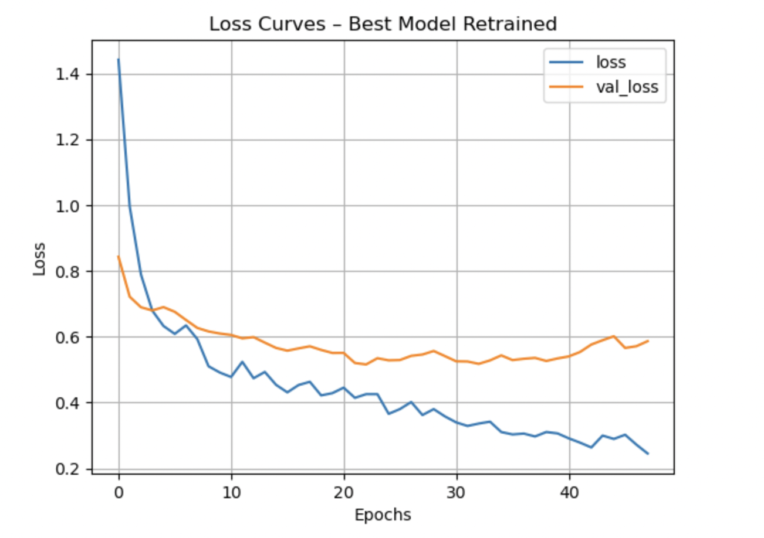

Neural Network Classification of Autoimmunity-Inducing Drugs Based on Molecular Features Aurora Caton¹ and Gideon K. Gogovi²
¹Department of Decision and Technology Analytics, ²Department of Biostatistics and Health Data Science
Introduction
Methodology Overview
Model Evaluation
Drug-Induced Autoimmunity (DIA) occurs when drugs trigger immune attacks on healthy tissue, posing serious risks in drug development. Early DIA prediction can identify problematic compounds and improve patient safety. This study applies a deep neural network to predict DIA using molecular descriptors from 597 compounds (477 training, 120 test) with 197 features each. We addressed class imbalance through multiple train-test splits, hyperparameter tuning, and threshold optimization. Performance was evaluated using sensitivity, specificity, accuracy, and F1 score to demonstrate deep learning potential for DIA risk detection.
Data Source: Huang, L. et al, 2025. InterDIA: Interpretable prediction of drug-induced autoimmunity through ensemble machine learning approaches. Toxicology
Accuracy: (TP + TN) / (TP + TN + FP + FN)
F1-Score: 2 × (Precision × Recall) / (Precision + Recall)
Sensitivity (Recall): TP / (TP + FN)
Specificity: TN / (TN + FP)
Where: TP = True Positives, TN = True Negatives, FP = False Positives, FN = False Negatives
Discussion
Class imbalance emerged as the primary challenge in this study, with the model showing a strong bias toward negative predictions that resulted in poor sensitivity. When the decision threshold was lowered from 0.5 to 0.3, sensitivity improved significantly, though this came at the cost of reduced specificity and overall accuracy. This highlights the important trade-offs involved in classification tasks for drug safety applications.
Among the different train-test splits evaluated, the 75/25 configuration provided the strongest overall performance, particularly in accuracy and F1 score. Five-fold stratified cross-validation further confirmed model stability and generalizability, achieving an average accuracy of approximately 80%. These results demonstrate that both threshold optimization and careful hyperparameter tuning are essential for developing reliable predictive models in pharmaceutical safety and DIA detection.
Conclusions
This study demonstrates the potential of deep neural networks for predicting Drug-Induced Autoimmunity. Our findings emphasize the critical importance of addressing class imbalance and optimizing decision thresholds to enhance sensitivity while maintaining model reliability. Through systematic evaluation of multiple data splits and hyperparameter optimization, the model achieved strong predictive performance and robust generalizability. These results suggest that deep learning approaches offer valuable capabilities for identifying DIA-risk compounds, potentially supporting safer and more efficient drug development processes.
Results
The 75/25 train-test split achieved optimal performance across all evaluation metrics. The best model architecture consisted of 2 hidden layers with 16 units each and 0.3 dropout rate. At the default threshold of 0.5, sensitivity was nearly zero due to class imbalance bias.
Lowering the threshold to 0.3 substantially improved sensitivity, enabling better detection of DIA-positive compounds while maintaining reasonable overall performance. Five-fold stratified cross-validation yielded an average accuracy of 80%, confirming robust model generalization across data partitions.

